Slide 1


DEPARTMENT OF COMPUTER SCIENCE AND ENGINEERING
20CS8504 & PROJECT WORK
CYCLE 2 REVIEW PRESENTATION
Batch No.: 07
Date: 16/03/2026
Session: FN

Slide 2
NUTRILIFE: AN AI-DRIVEN PERSONALIZED GROCERY PLANNING SYSTEM FOR
HEALTHY AND AFFORDABLE LIVING
Guide Name:
Mrs.A.DHIVYA BHARATHI M.E(Ph.D.,)
ASSISTANT PROFESSOR
Team Members:
(811722104082)LOGESHWARAN.P
(811722104113)PRITHICK ROSHAN.S
(811722104116)RAGHUL.P
(811722104124)RIYAZ AHMED.H

Slide 3
OBJECTIVE OF THE PROJECT
Develop an AI-based system for personalized grocery planning based on users’ health conditions and dietary needs.
Provide nutritionally balanced and cost-effective grocery recommendations for individuals and families.
Reduce food waste and promote healthier eating through data-driven grocery planning.

Slide 4
INTRODUCTION
Many people find it difficult to plan groceries that balance nutrition, health needs, and budget.
Most existing grocery and meal planning applications provide only general food suggestions.
These systems usually ignore individual health conditions and specific dietary requirements.
As a result, users often receive recommendations that are not personalized or medically relevant.
NutriLife solves this problem by using AI to generate customized grocery plans based on health profiles, nutrition goals, and budget constraints.

Slide 5
LITERATURE SURVEY
TITLE OF PAPER | AUTHOR(S) | PAPER GIST | TECHNOLOGY USED
AI-Powered Meal Planner | N.Punitha,Aswini Sibi | IJRPR(2025) | Machine Learning, Health Data Analysis
Nutrition Recommendation System for Healthy Living | A. Jain, P. Singh | International Journal of Computer Applications(2019) | Data Mining, Recommendation Algorithm
Smart Grocery System Using Artificial Intelligence | H. Zhang, J. Li, M. Ma | IEEE Conference(2020) | Artificial Intelligence, IoT
AI-Driven Grocery Recommendation Model | S. Lee, Y. Kim | ACM HealthTech(2022) | Machine Learning, User Preference Modeling
Intelligent Grocery Planning for Food Waste Reduction | A. Sharma, P. Arora, M. Das | International Journal of Advanced Computer Science(2020) | AI-Based Planning, Data Analytics
AI-Based Meal Planning System for Chronic Disease Management | A. Sharma, R. Verma | IEEE Conference(2021) | Machine Learning, Health Data Processing
Personalized Nutrition Planning Using User Health Profiles | N. Patel, S. Mehta | International Journal of Computer Science(2020) | Recommendation Systems, Data Analytics
Smart Food Recommendation System Using AI | M. R. Patel, D. S. Rana | International Journal of Engineering Research(2020) | Artificial Intelligence, Rule-Based Systems

Slide 6







EXISTING SYSTEM ARCHITECTURE
User
No Health Analysis
Manual Grocery Selection
Generic Food Apps / Local Stores
Unhealthy Diet & Food Wastage
Unplanned Grocery Purchase
No Budget Optimization

Slide 7
PROBLEM IDENTIFICAITON
1. Difficulty in planning groceries that balance nutrition, health conditions, and budget.
2. Existing grocery apps provide generic recommendations without personalization.
3. Lack of systems that consider individual health conditions and dietary restrictions.
4. Inefficient grocery purchasing often leads to food wastage.
5. Need for a smart solution that integrates nutrition analysis with grocery planning.

Slide 8


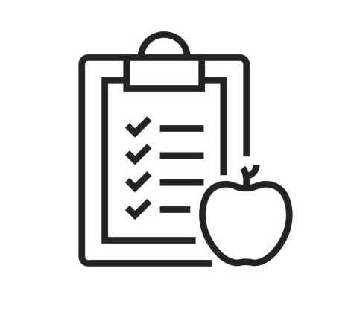




PROPOSED SYSTEM ARCHITECTURE
User Profile Input
User
AI Recommendation Engine
Healthy Diet + Cost Optimization
Grocery Package Generator
Recipe & Meal Suggestions
8

Slide 9
SOFTWARE AND HARDWARE REQUIREMENTS
HARDWARE
1. Processor: Intel Core i3 or higher
2. RAM: Minimum 4 GB (8 GB recommended)
3. Storage: At least 20 GB free disk space
SOFTWARE
1. Operating System: Windows / Linux / macOS
2. Programming Language & Framework: Python with Django
3. Database & Tools: PostgreSQL, Redis, Docker

Slide 10
MODULES
1. User Profile Management Module
2. AI Recommendation Module
3. Nutrition Analysis Module
4. Grocery Package Management Module
5. Recipe and Meal Guidance Module

Slide 11
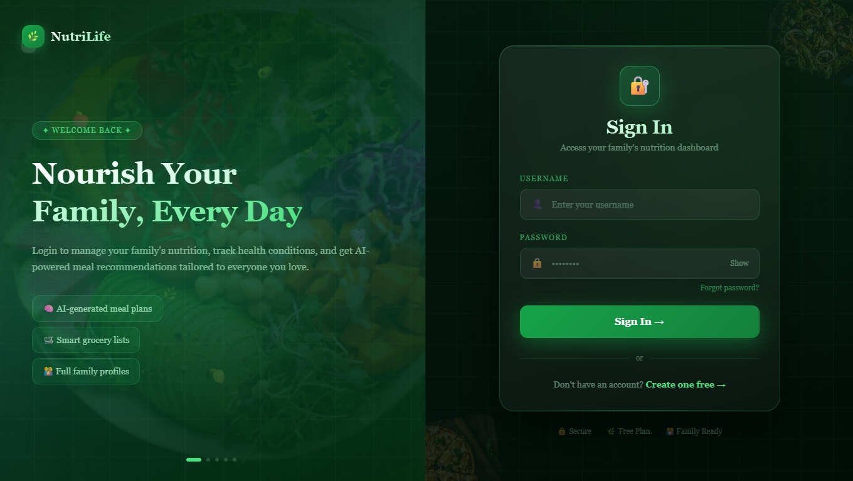
IMPLEMENTATION OF MODULE-1
1.Collects user details such as age, gender, height, weight, and BMI.
2.Stores information about medical conditions like diabetes, hypertension, etc.
3.Records dietary preferences
4.Captures allergy information to prevent unsafe recommendations.
5.Allows users to update profile data dynamically.

Slide 12
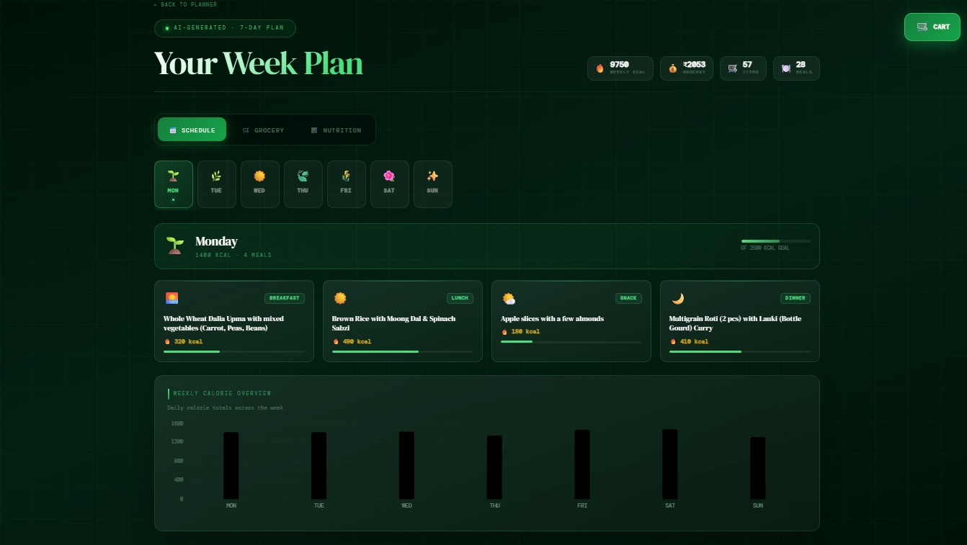
IMPLEMENTATION OF MODULE-2
1.Processes user profile data to generate personalized grocery suggestions.
2.Applies rule-based logic and filtering techniques.
3.Categorizes users into Normal, Special, or Premium packages.
4.Performs health-based filtering (low sugar, high protein, etc.).
5.Matches food items with user taste preferences.

Slide 13
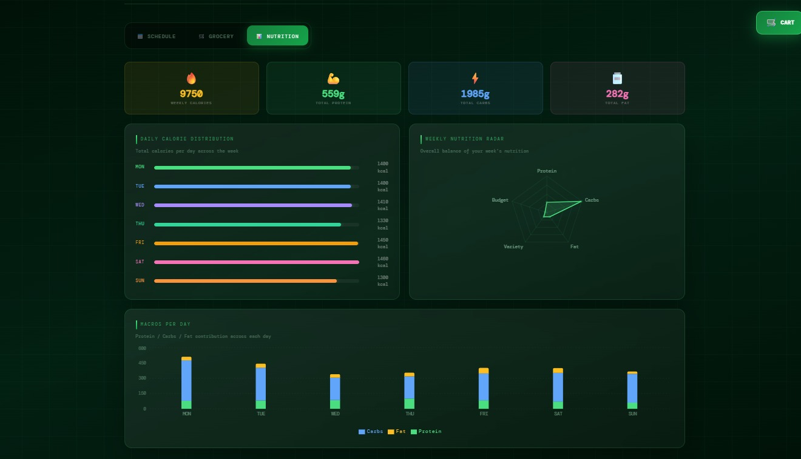
IMPLEMENTATION OF MODULE-3
1.Calculates calorie requirements based on
BMI and activity level.
2.Evaluates macronutrients (protein, carbs, fats).
3.Analyzes micronutrients (vitamins, minerals).
4.Compares nutrient intake with daily
recommended values.
5.Identifies nutritional deficiencies.

Slide 14
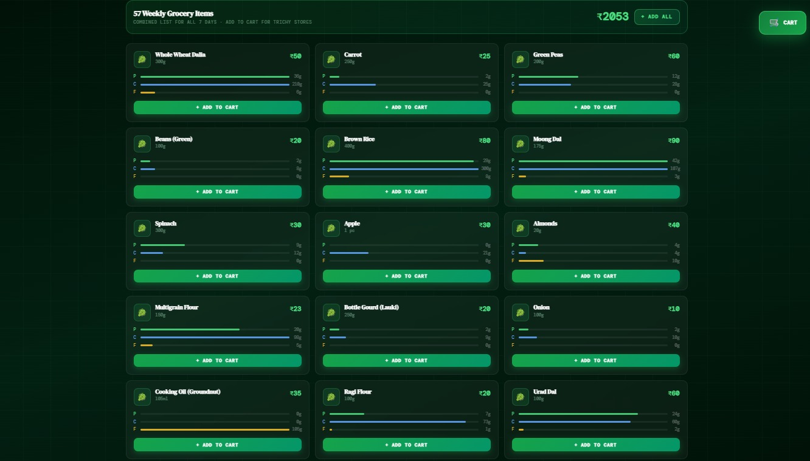
IMPLEMENTATION OF MODULE-4
1.Generates weekly or monthly grocery plans.
2.Automatically creates structured grocery lists.
3.Allows addition and removal of items.
4.Suggests healthier substitutes for selected items.
5.Performs basic budget estimation

Slide 15
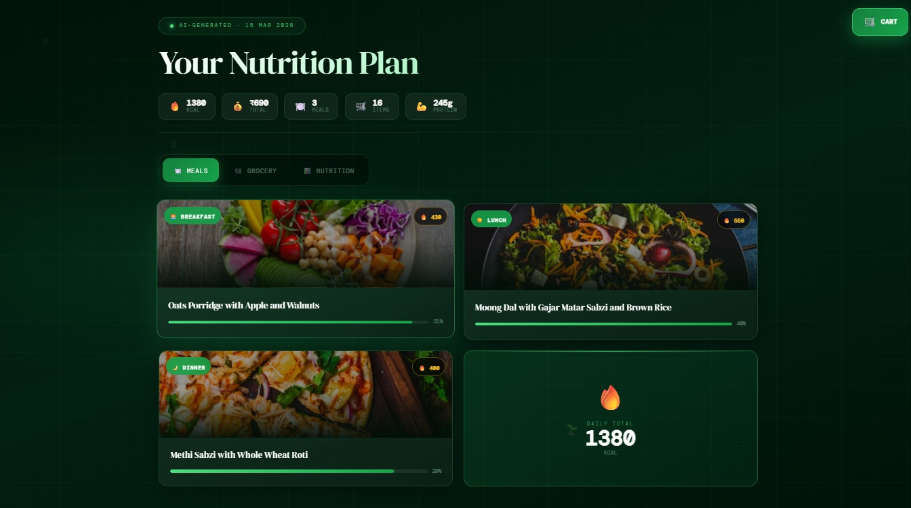
IMPLEMENTATION OF MODULE-5
1.Suggests recipes based on selected grocery items.
2.Provides step-by-step cooking instructions.
3.Recommends portion sizes for balanced meals.
4.Supports health-specific recipes (diabetic-friendly, low-sodium).
5.Reduces food waste by suggesting meals using available groceries.

Slide 16
CONCLUSION
Uses AI for personalized grocery planning.
Considers health conditions and dietary needs.
Provides balanced and affordable grocery suggestions.
Promotes healthier eating habits.
Reduces food waste through smart planning.

Slide 17
FUTURE ENHANCEMENTS
1. Develop a mobile application for easier access.
2. Improve AI recommendations using machine learning.
3. Integrate online grocery store ordering
4. Add real-time nutrition and health tracking.

